Slide 1
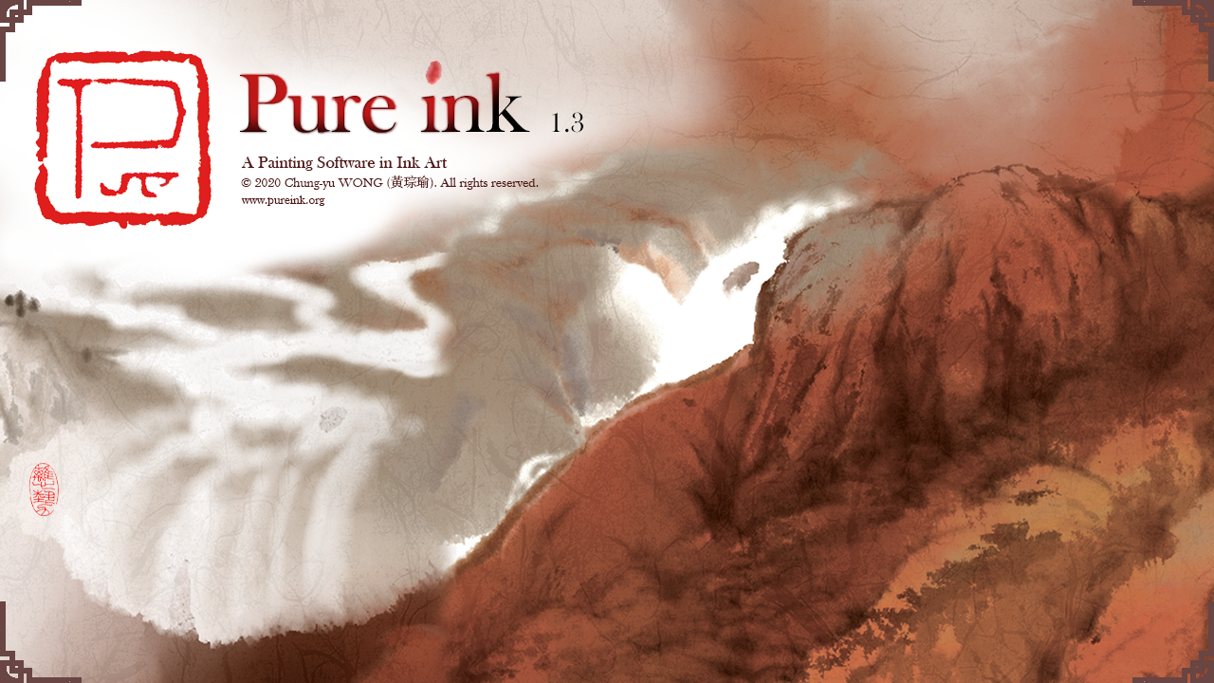

Slide 2
界面 The Interface

Slide 3
界面 The Interface

Slide 4
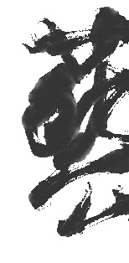
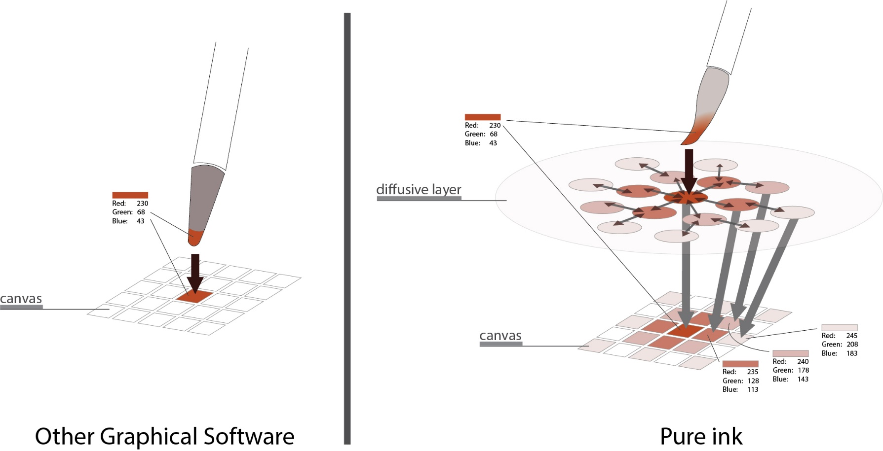
系統 System
系統於畫筆及畫紙之間存在一個滲染層處理實時滲染效果
Pure ink equips with a diffusive layer in between the brush and the paper (canvas) to process diffusion in real time

Slide 5
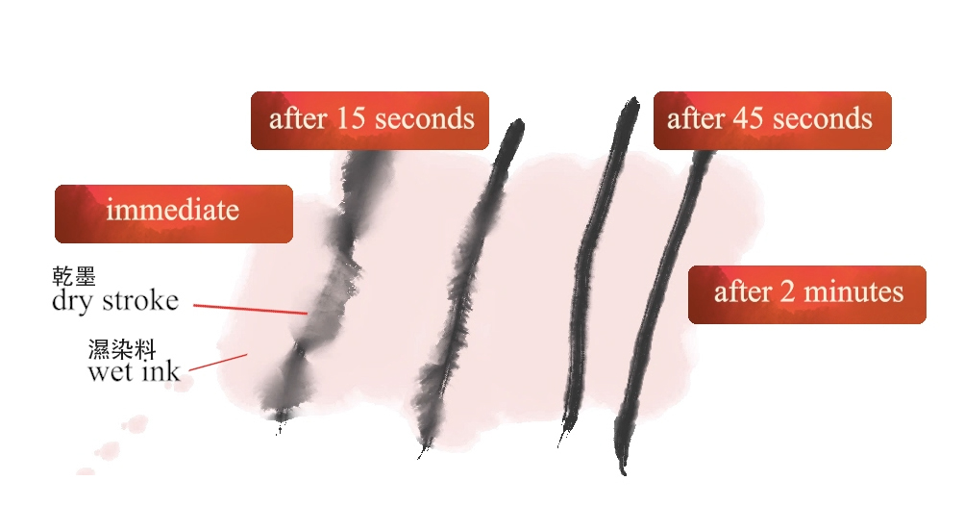
系統 System
滲染是實時進行的
diffusion is done in real time
顏料只會於滑鼠進入畫紙範圍內才進行實時滲染
pigment only diffuses when cursor enters the paper

Slide 6
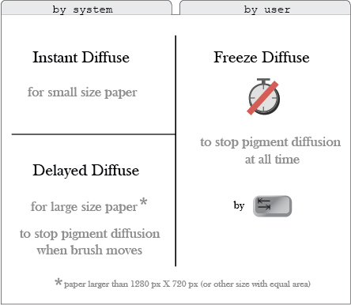
系統 System
在不同情況下系統運用不同滲染模式增加效率
Different diffusion approaches are adopted under different situations to enhance performance

Slide 7
系統 System
基本運作需8G RAM，高強度運作需16GB RAM(例如高解析度輸出大面積畫紙)
8G RAM for basic operation, and 16G RAM for intensive production like high resolution output of paper in large size.

Slide 8
運筆 Brush Usage
Pure ink 以推動數碼水墨藝術普及化為
目標，只需滑鼠及鍵盤已可完全操控毛筆，
但同時亦支援使用wacom壓力畫板
With the purpose of promoting Digital Ink Art and making it universal, Pure ink allows full control of the brush by mouse and keyboard. It however also supports pressure stylus (wacom)

Slide 9
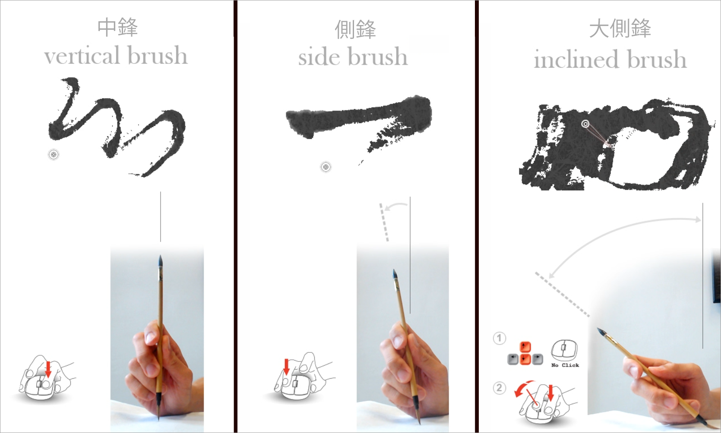
運筆 (中鋒、側鋒、大側鋒 ) Brush Usage (vertical, side, inclined brush)
有三種運筆方法
按滑鼠左右鍵交替轉換正鋒與側鋒
按 x 鍵交替轉換正鋒與大側鋒
按左右箭咀鍵調教畫筆大小
There are three ways to operate the brush
Press left and right button of the mouse to swap between vertical and side brush
Press ‘x’ to swap between vertical and inclined brush
Press left and right arrow keys to adjust brush size

Slide 10
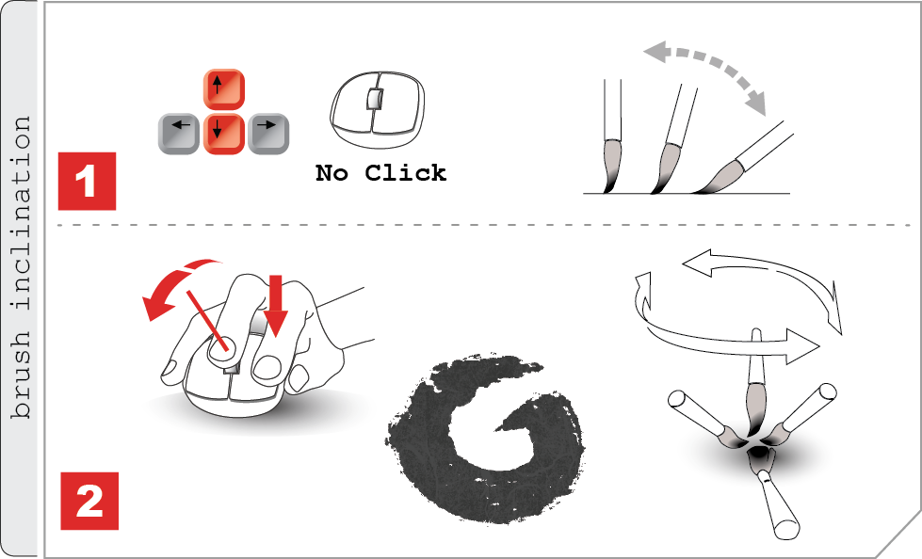
運筆(大側鋒 ) Brush Usage (inclined brush)
在沒有按動滑鼠作畫的時候，按上下箭咀鍵可改變毛筆的傾斜角度，令畫筆變成大側鋒 (亦可按x鍵)
Pressing the up/down arrow keys when the mouse is not in use can change the angle of inclination and turn the brush to inclined brush. (alternatively, press x key)
在使用大側鋒的同時按上下箭咀鍵或轉動滑鼠中輪改變毛筆的傾斜方向
Pressing the up/down arrow keys or rotate the mouse wheel to control the direction of the inclination while brushing

Slide 11
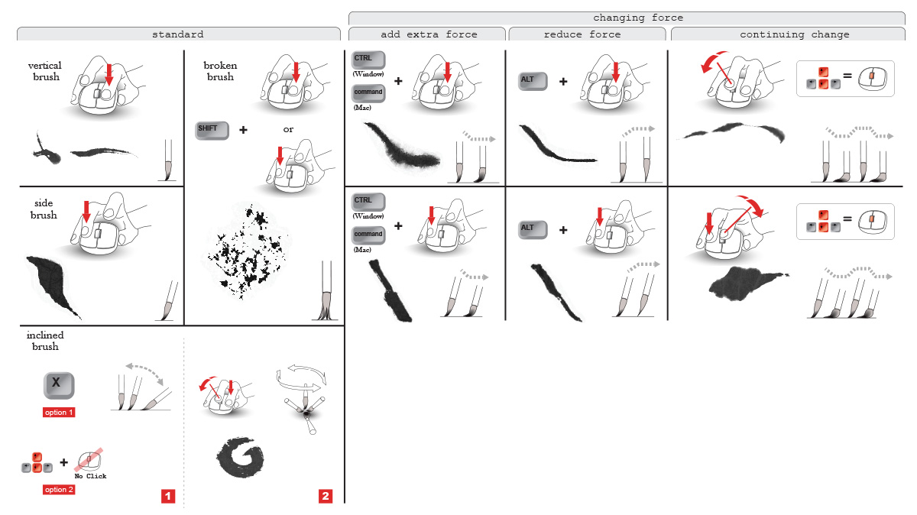
運筆 Brush Usage
在使用正峰或側鋒的同時按 CTRL (command for Mac) / ALT / 上下箭咀鍵或轉動滑鼠中輪改變按壓毛筆的力度
Pressing the CTRL (or command in Mac) / ALT / up or down arrow keys or rotate the mouse wheel to change the pressing force while using vertical or side brush. This produces strokes with various thickness

Slide 12
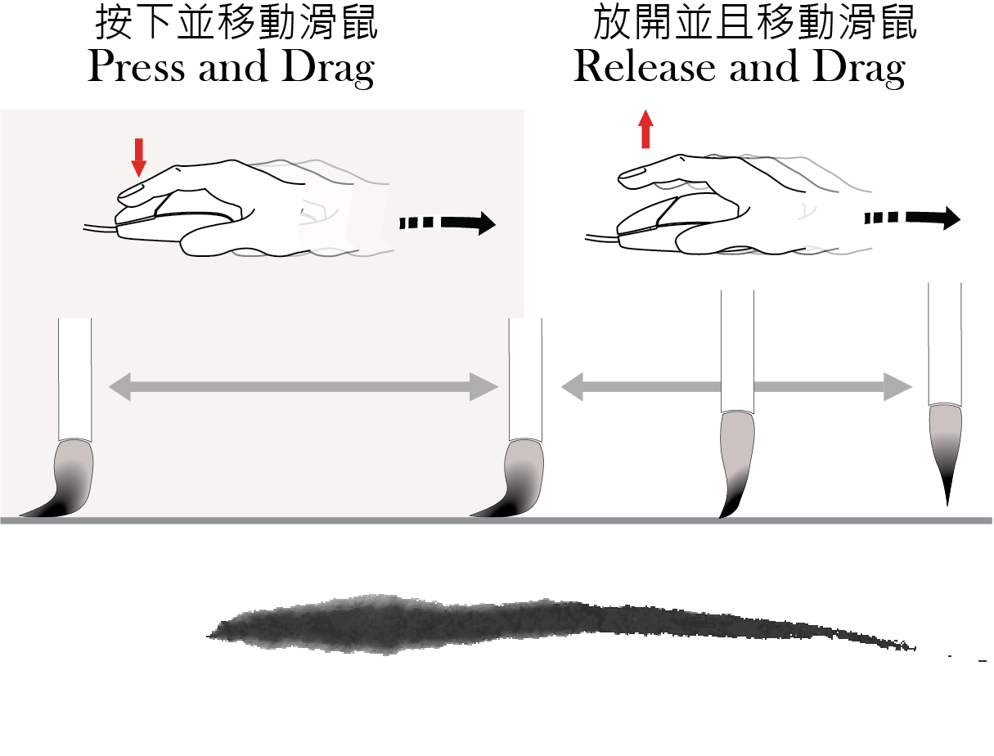
運筆 Brush Usage
放開滑鼠左鍵同時保持滑鼠移動，可產生尖尾效果
To create stroke with fine tail, release the left button of the mouse while dragging it

Slide 13
如何畫出好線條 How to Draw a Nice Stroke
以多變速度運筆
move your brush with varying speed

Slide 14
如何畫出好線條 How to Draw a Nice Stroke
水墨畫筆具有高彈性力，而水墨畫紙則有較強的吸水力。運筆速度影響顏料為畫紙所吸收的量，從而決定線條形態。 以多變速度運筆可產生具動感、 形態多變的線條
The brush in ink art is highly elastic and the paper for ink art absorbs water heavily. The speed of brush determines the amount of pigment being absorbed by paper and thus the shape of the stroke. A brush moving with varying speed creates dynamic stroke with interesting changes of shapes

Slide 15
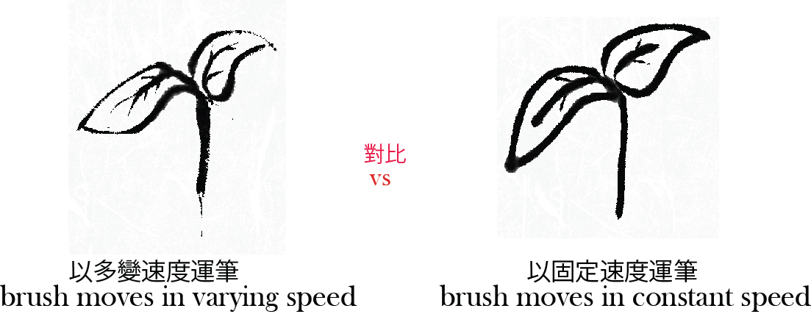
如何畫出好線條 How to Draw a Nice Stroke

Slide 16
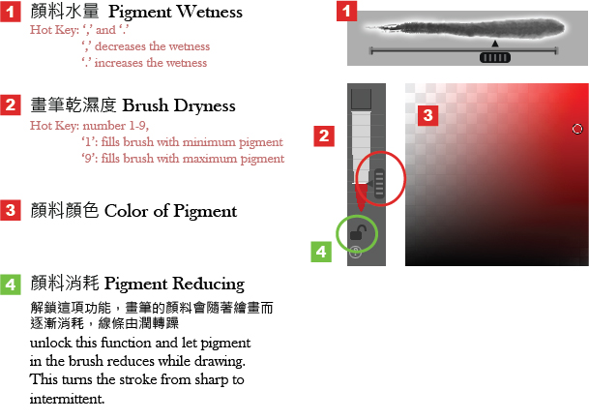
調色 To Set the Pigment

Slide 17
調色 To Set the Pigment
Q:
為什麼我不能畫出我心中想要的效果?
Why can't I paint the effects that I want?
A:
你沒有把顏料正確調校好。請記住，顏料
並不單純等於顏色。
顏料 = 顏料水量 + 畫筆乾濕度 + 顏色值
You do not set the right pigment. Remember: pigment doesn't just mean color.
Pigment = wetness of pigment + brush dryness + color

Slide 18
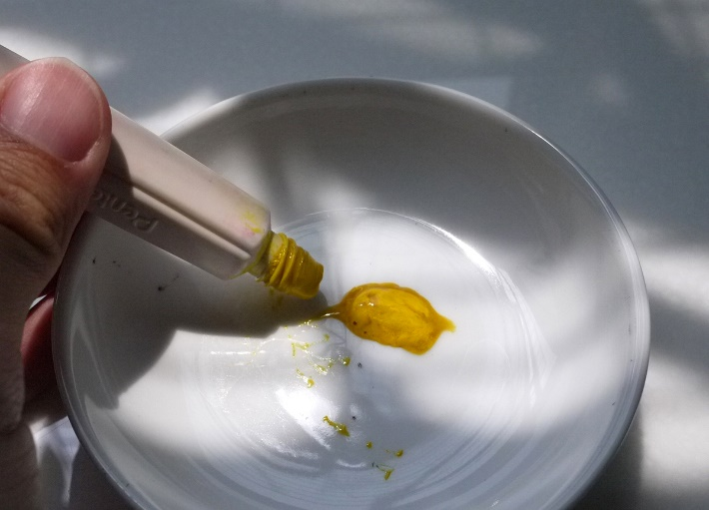
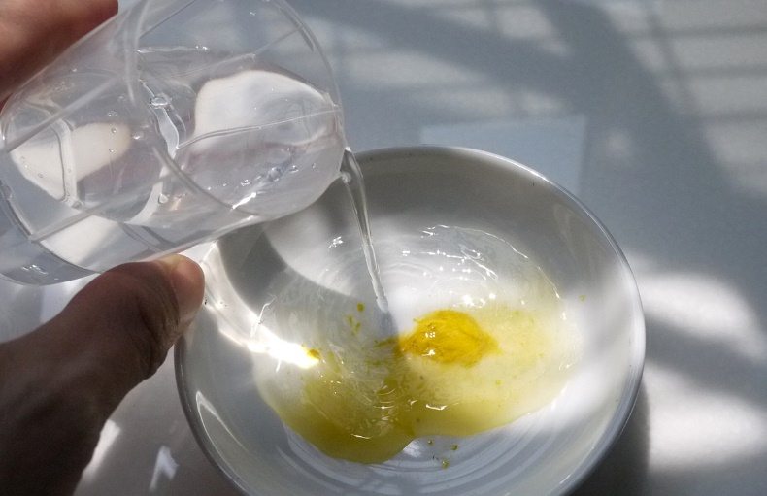
調色 To Set the Pigment
Q:
什麼是顏料水量？
What is wetness of pigment?
A:
是指稀釋顏料的水份量。
it is the amount of water to dilute a pigment
low wetness
high wetness

Slide 19
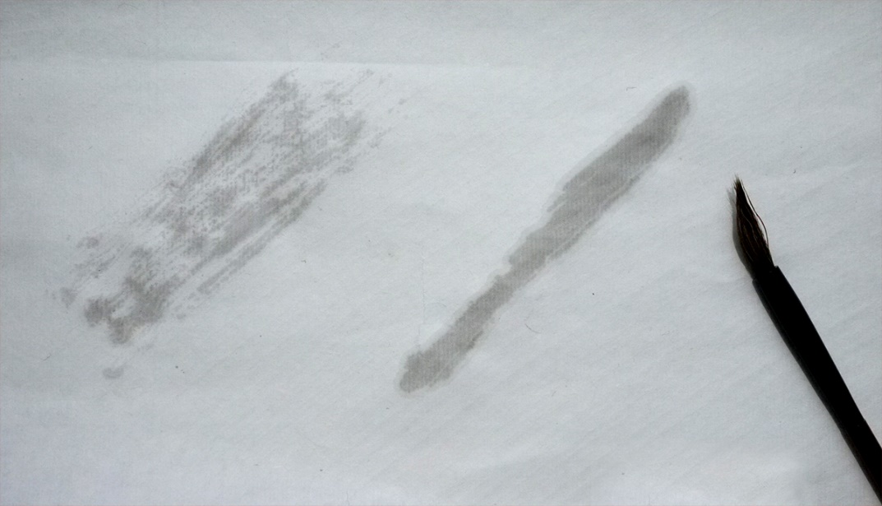
調色 To Set the Pigment
Q:
什麼是畫筆乾濕度？
what is brush dryness?
A:
是指畫筆攜帶的顏料量。 畫筆乾濕度通常影響線條連貫性。
It is the amount of pigment stored in the brush. Usually brush dryness affects the continuity of stroke
brush with litter pigment
brush with much pigment

Slide 20
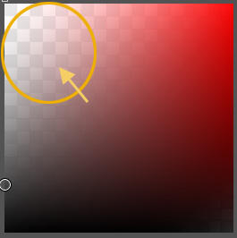
調色 To Set the Pigment
Q:
顏色的亮度代表什麼？
what does the lightness of color mean?
A:
亮的顏色比較透明。
light color tends to be more transparent
light color does not cover dark color

Slide 22
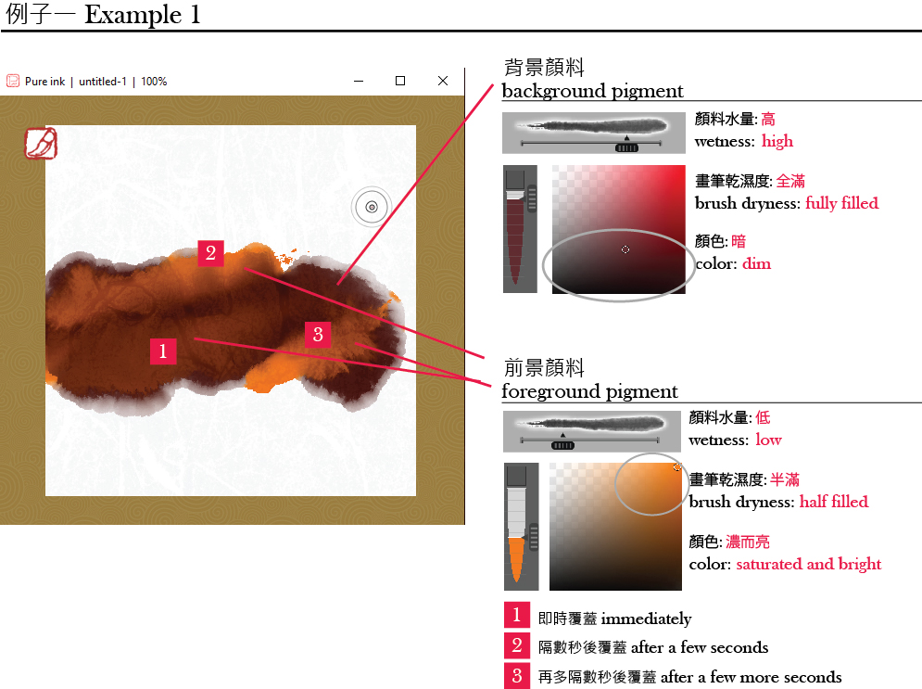
顏料滲染 How to make pigment diffuse
濕潤的顏料能滲染。 如果兩種顏料的畫筆乾濕度及/或水量存在較大差別時，顏料可產生明顯的滲化效果
Wet pigment can diffuse. To make the diffusion nice, set the brush dryness and/or the wetness of the foreground and background pigment with a certain difference.

Slide 23
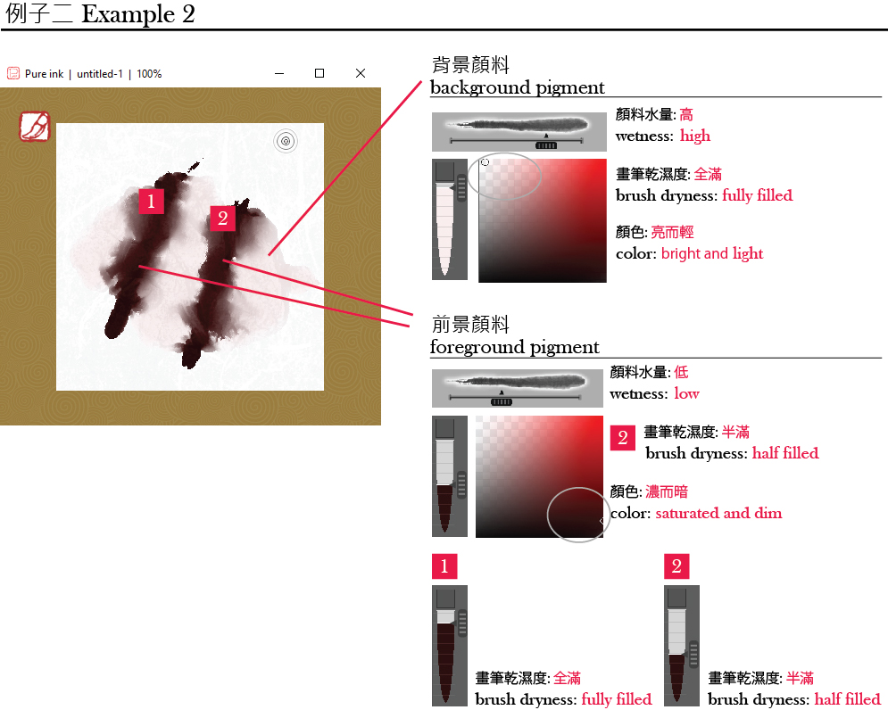
顏料滲染 How to make pigment diffuse

Slide 24
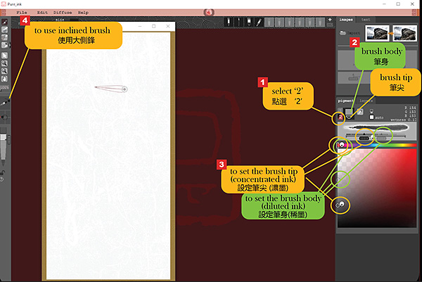
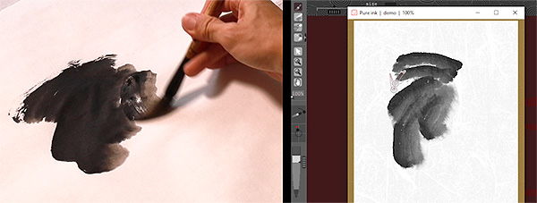
一筆雙色One Brush Two Colors
在Pigment控制板中選 ‘2’
分別選象徵筆尖及筆肚的半圓形及方形圖示
筆尖及筆肚獨立調色
建議使用大側鋒
Select ‘2’ to activate one-brush-two-colors
individually select brush tip or body
Set pigment for brush tip or body
Apply one-brush-two-colors by inclined brush

Slide 25
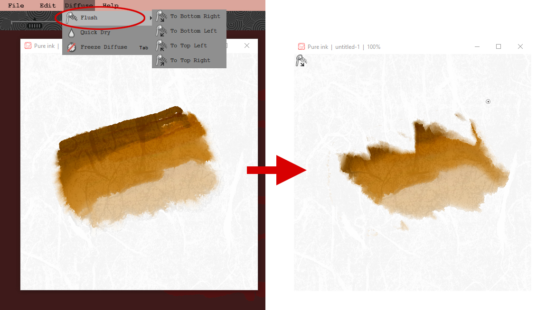
顏料沖洗器 Color Flusher
顏料可向不同方向沖洗產生特殊效果
Color can be flushed toward different direction to achieve unexpected effects

Slide 26
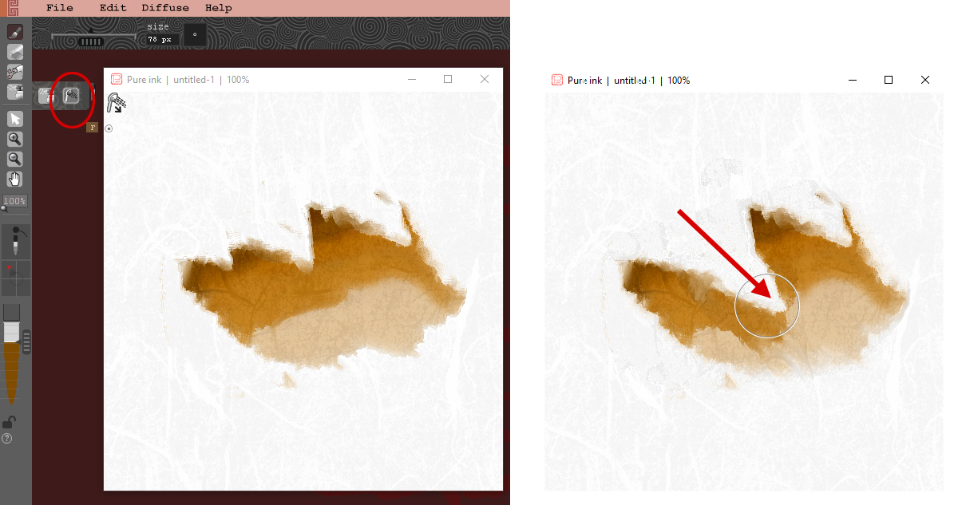
顏料沖洗器 Color Flusher
使用顏料沖洗器局部沖洗紙張上特定地方的顏色
Use Color Flusher to partly flush the colors on a specific area of the paper

Slide 27
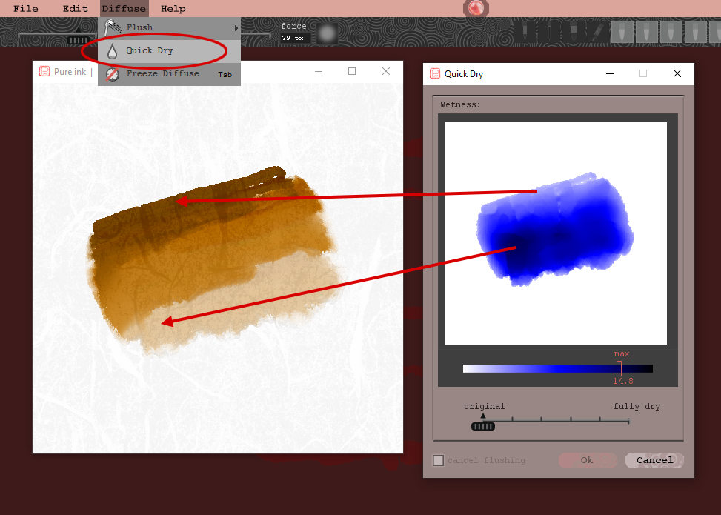
顏料速乾 How to stop pigment diffuse
透過 Quick Dry 功能可監察紙張濕度分佈及不同程度地弄乾紙張
Use Quick Dry to monitor and to reduce the moisture of the paper to different level

Slide 28
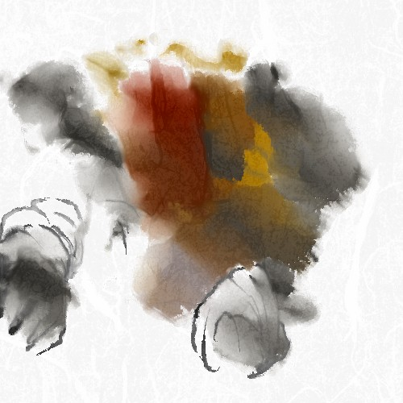
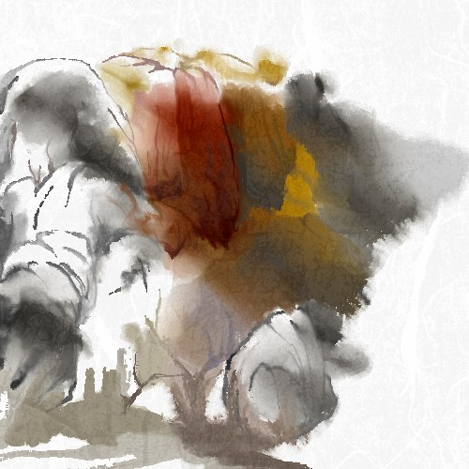
顏料滲染應用 How to apply diffusion effects
混合顏色沖洗及速乾的方法佈局，令畫作產生隨意效果
To create unexepected effects by combining the use of Color Flushing and Quick Dry

Slide 29
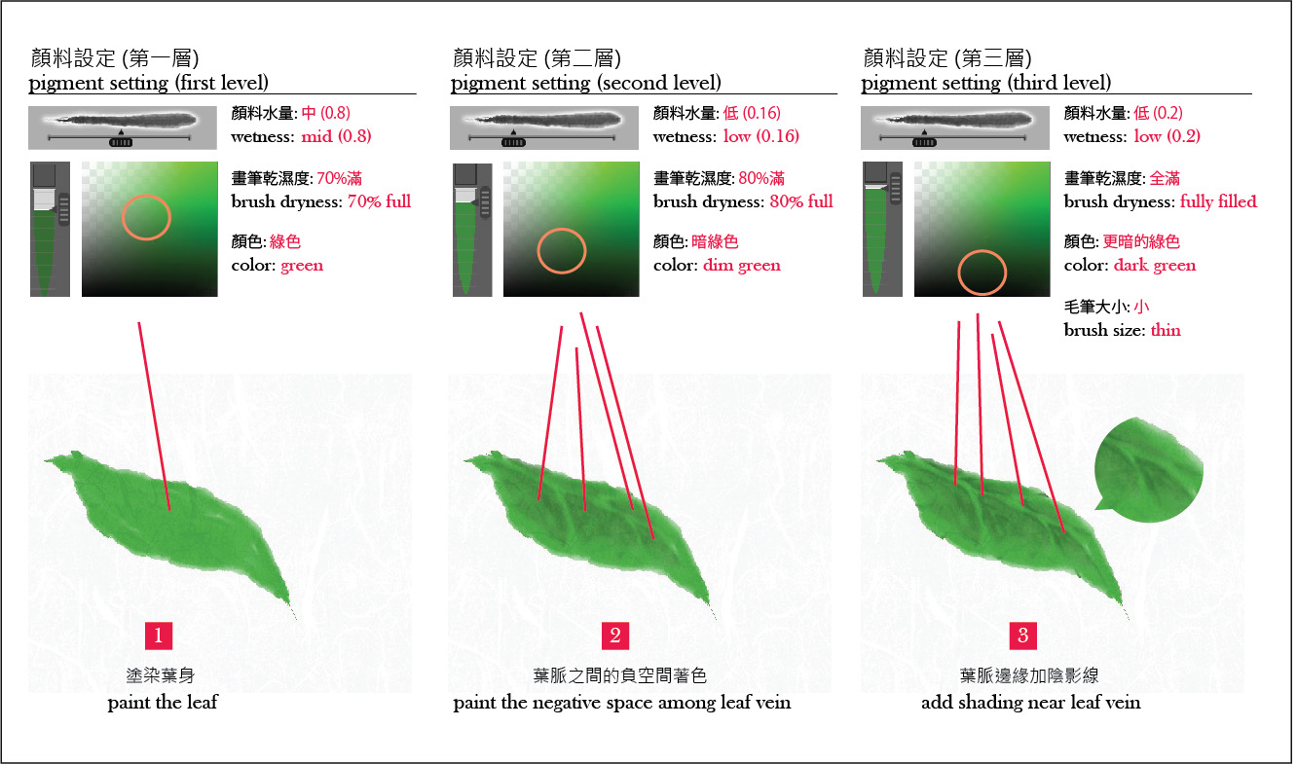
顏料堆疊 How to make pigment overlap
顏料的水量決定其濃度及透明度。 低水量提高顏料濃度，會令顏料較不透明，容易覆蓋到其他顏料之上 ，產生層次感
The wetness value of pigment determines its concentration and thus the opacity. Low wetness makes pigment more concentrated and thus more opaque. This makes the it easier to overlap the other pigments and creates a sense of hierarchy

Slide 30
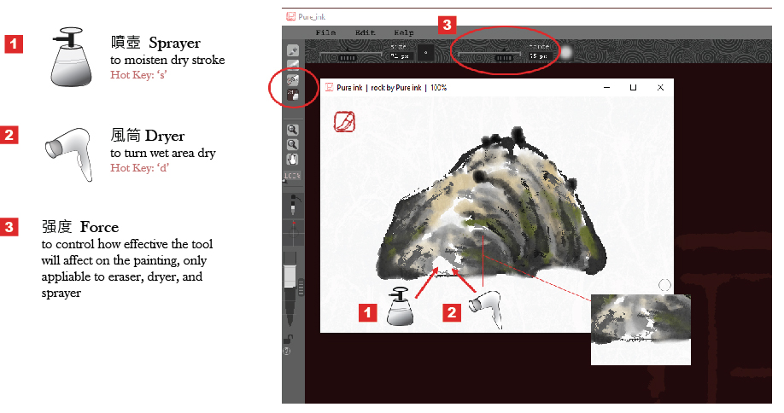
噴壺與風筒 Sprayer and Dryer

Slide 31
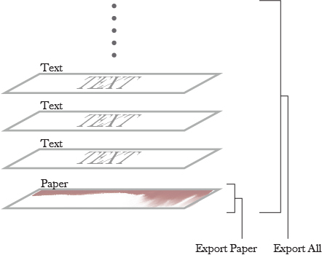
圖層 Layer
只有畫紙層可以繪畫。 畫紙層以上所有圖層都是處理文字的文字層
Only the paper layer can be painted. All layers on top of the paper layer are for text
選擇“輸出紙張”僅將畫紙圖層輸出為圖像。選擇“全部輸出”則可將所有可見圖層輸出為圖像。
Selecting 'Export Paper' only exports the paper layer as an image. Selecting 'Export All' exports all visible layers as an image

Slide 32
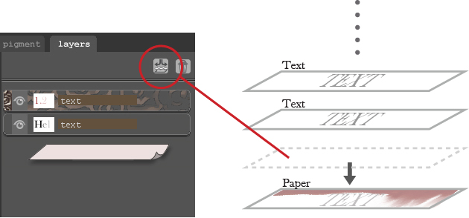
圖層 Layer
文字層的字體可以 融合到畫紙層中，並產生滲染效果。
Text can be applied into the paper layer with diffusive effect.
融合到畫紙層的字體不再可編輯， 但變成可繪畫的對象
The text applied into paper is no longer editable but becomes paintable.

Slide 33
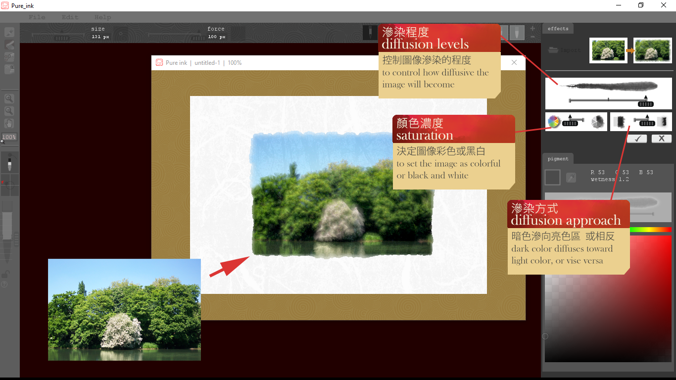
影像處理 Image Processing

Slide 34
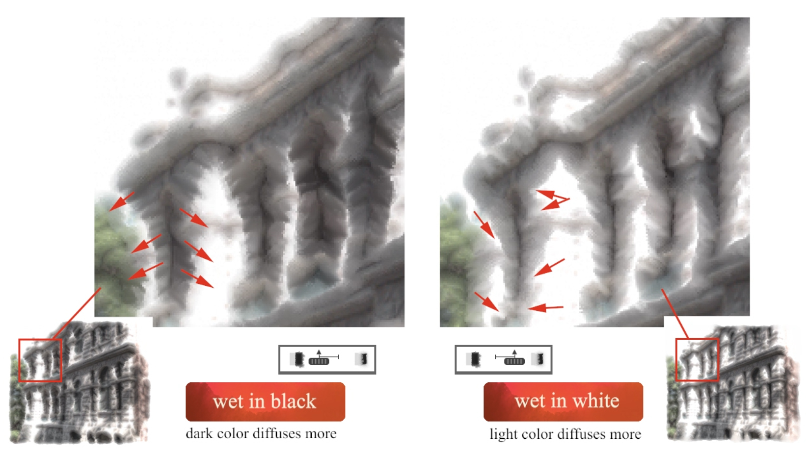
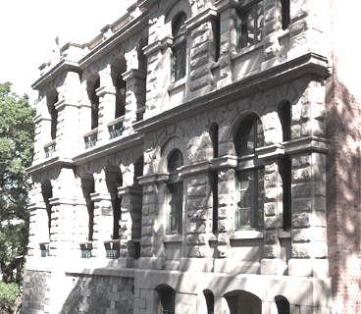
滲染方式 Diffusion Approach
暗色滲向淺色區
淺色滲向暗色區

Slide 35
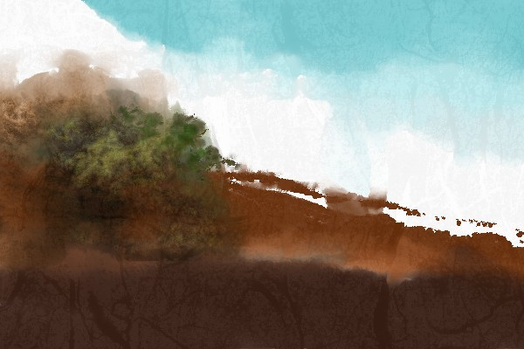
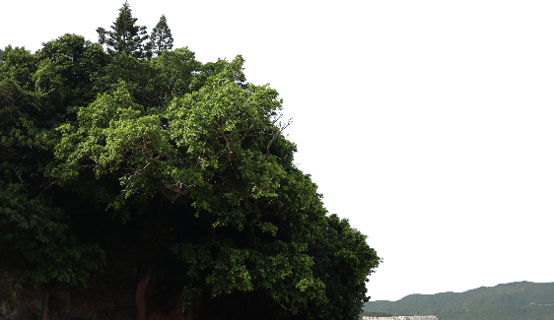
影像處理應用 (1) Application of Image Processing (1)
(transparent png)
(transparent png)
將圖像匯入產生濕染效果， 結合Pure ink內手繪的筆觸
To import an image to create diffusive effect and integrate it with Pure ink brushworks

Slide 36
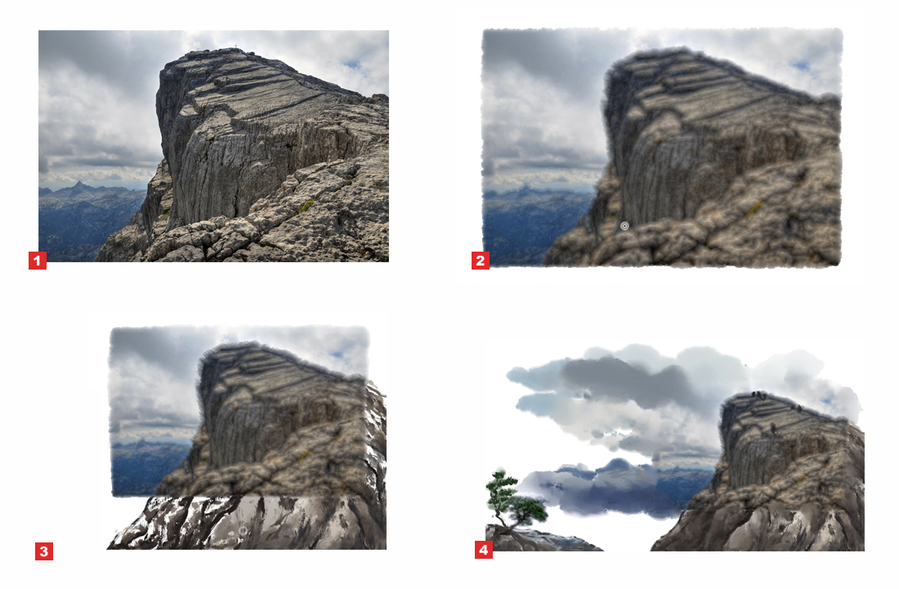
影像處理應用 (2) Application of Image Processing (2)
將圖像轉成具水墨滲染的效果，然後再用畫筆將其延伸為完整畫面
To convert an image to ink style picture and extend it to a painting by brush

Slide 37
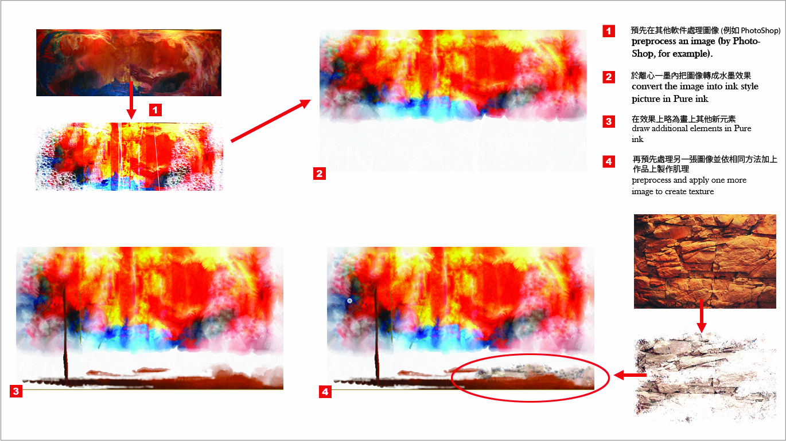
影像處理應用 (3) Application of Image Processing (3)
製作具表現性的抽象肌理或效果
To create abstract patterns or texture for expressive effects

Slide 38
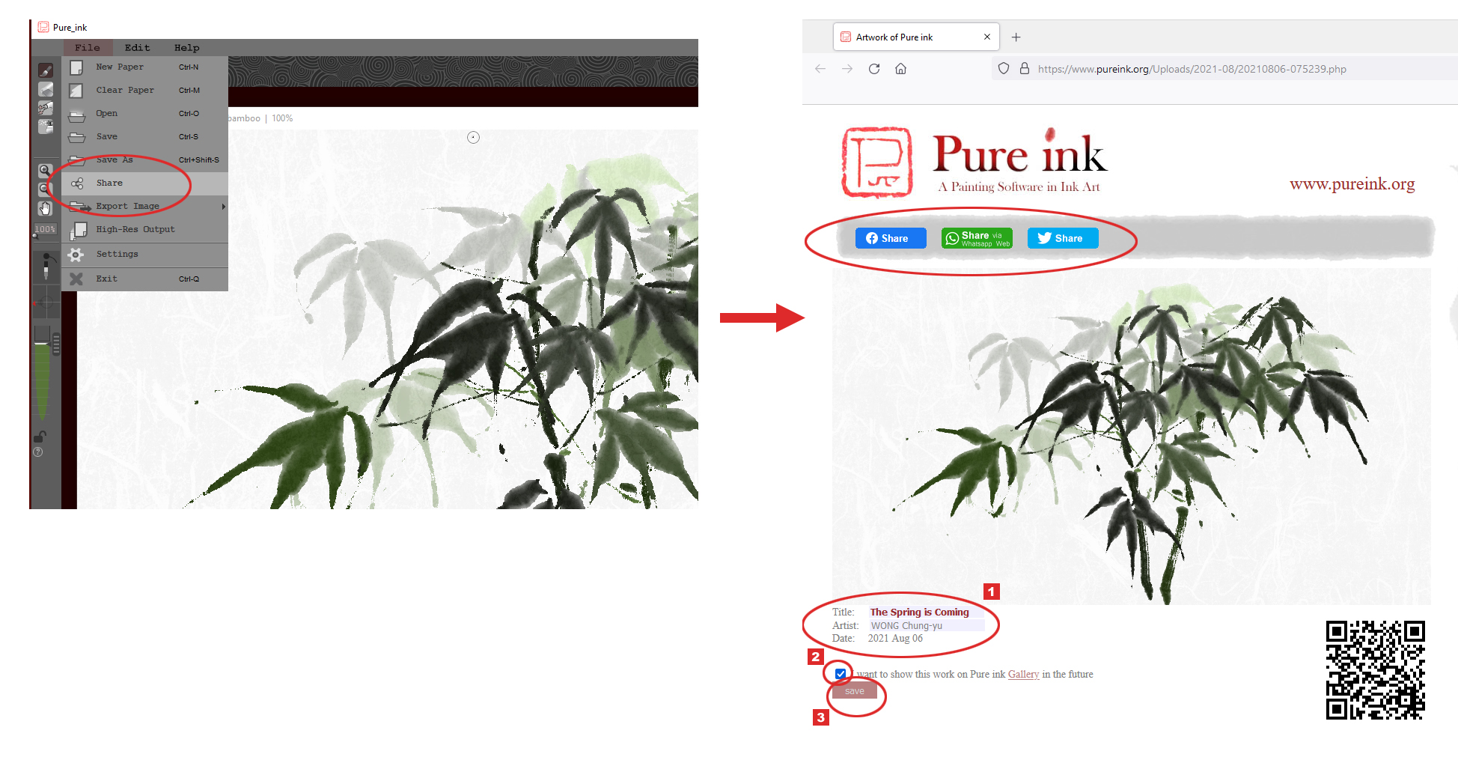
線上分享 Sharing
按 “share” 鍵為你的作品建立一張網頁，輸入作品資料 (1)，在save選項加上剔號 (2)，
最後按 “save” 鍵 (3)
Pressing “share” button to create a web page for your work. Enter information of your work (1), add a tick to the save box (2), then click “save” (3)

Slide 39
高解析度印刷 High Resolution Output
300 dpi
CMYK color
TIFF format

Slide 40
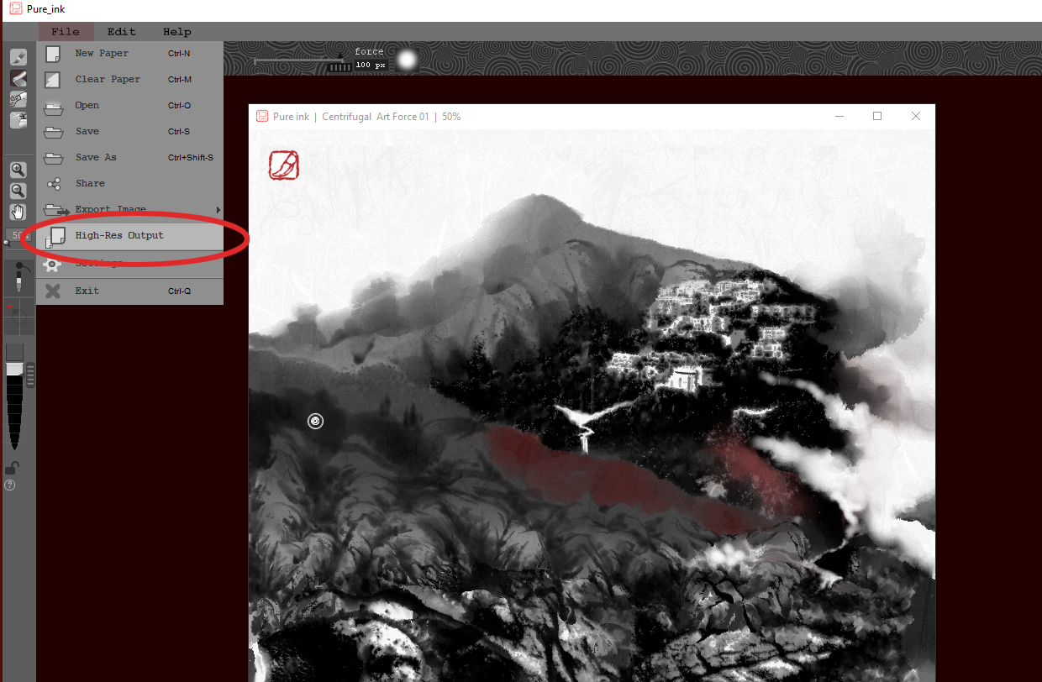
高解析度印刷 High Resolution Output
簡單按 “High-Res Output” 鍵將作品輸出成高解像度圖像
Simply click “High-Res Output” to output your work to a high-resolution image

Slide 41
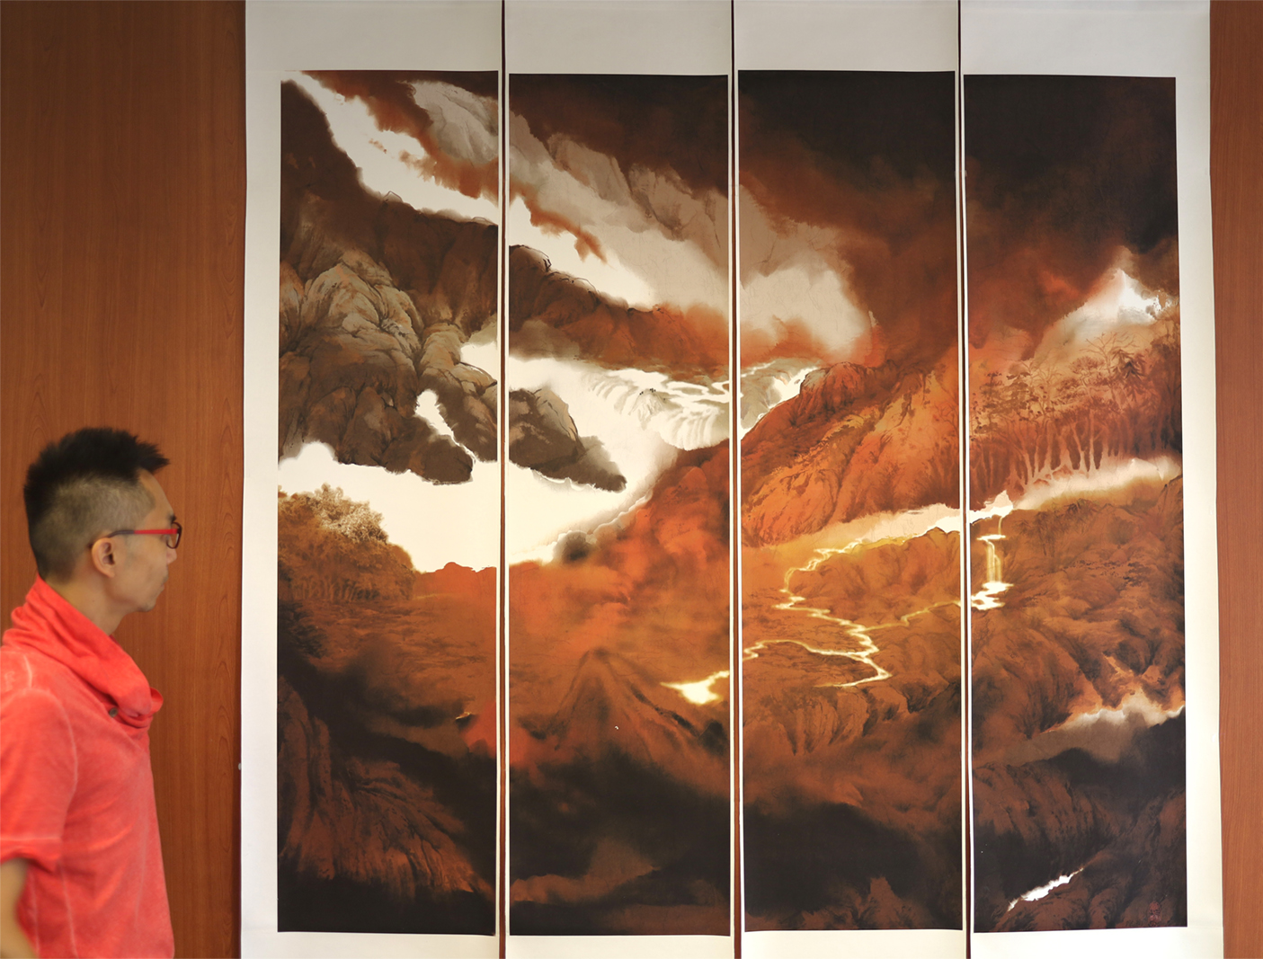
Digital Painting
看莽莽南徐，蒼蒼北固
38cm x 152cm (for each portion)
152cm x 152cm (the whole piece)

Slide 42
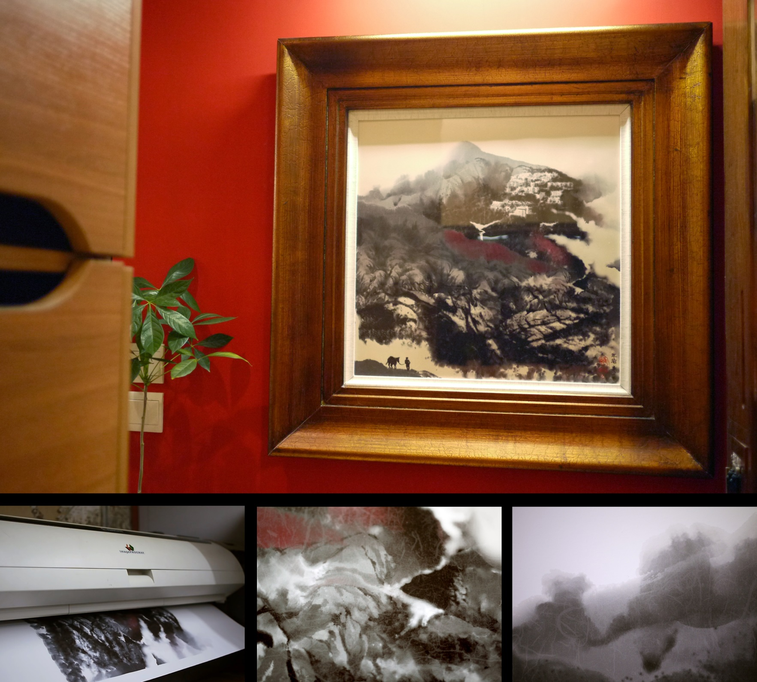
Digital Painting
離心茫茫 煙蒼蒼
55cm x 55cm

Slide 43
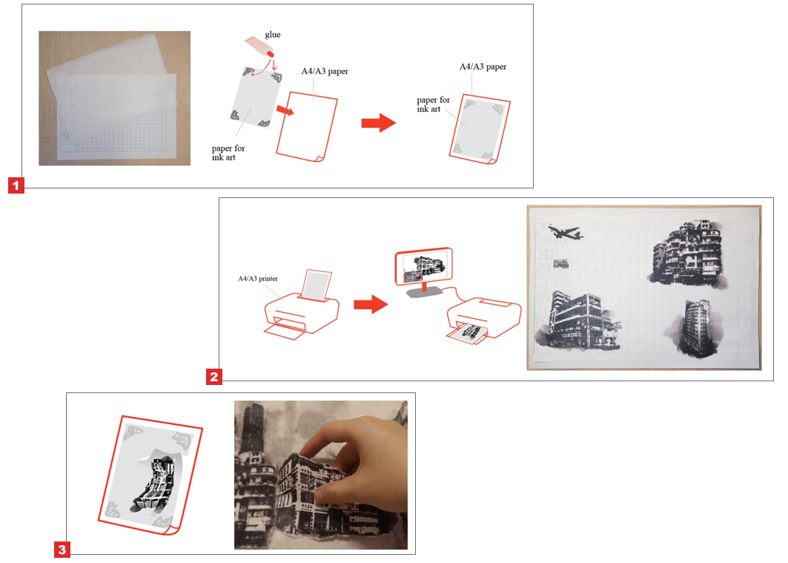
高解析度印刷(應用) High Resolution Output (application)
將離心一墨畫面列印到水墨畫紙上，然後撕出
作為拼貼材料
To print the paintings on Chinese paper, tear off as collage materials

Slide 44
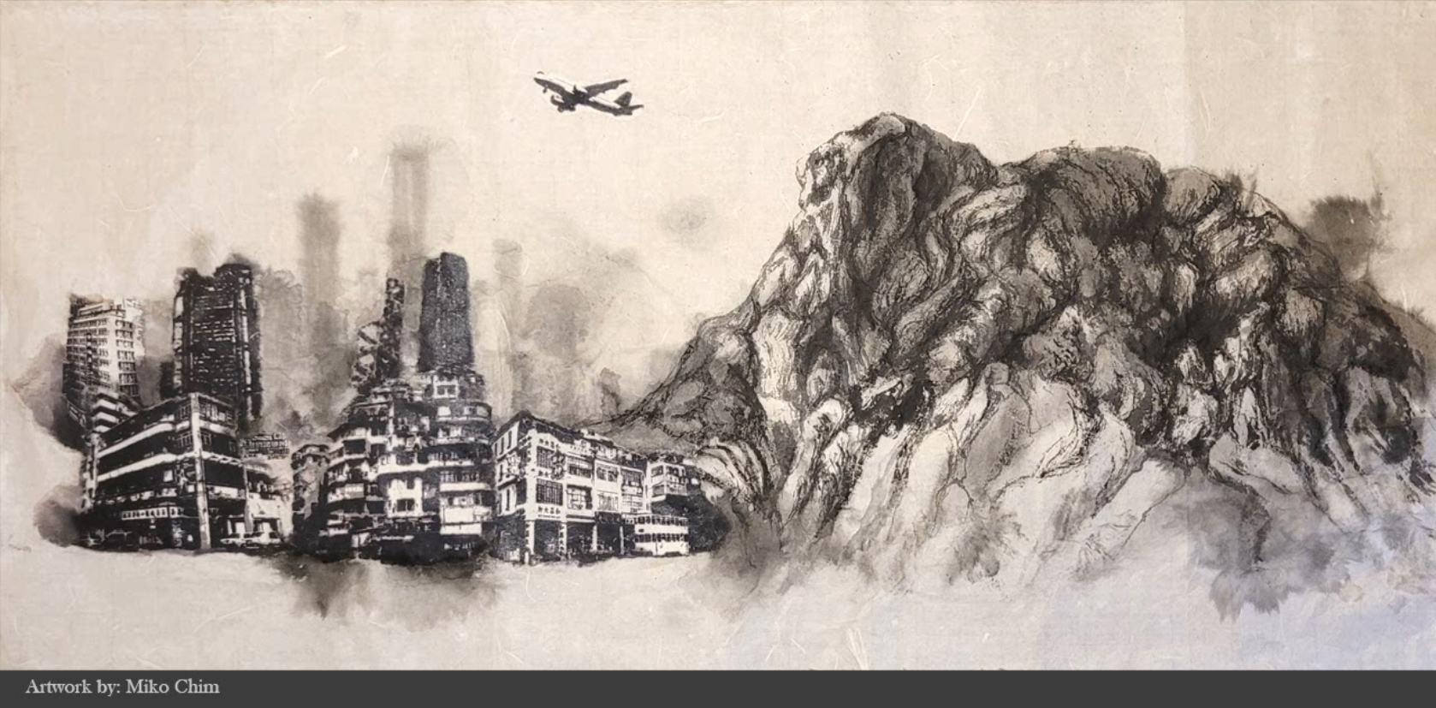
Collage

Slide 45
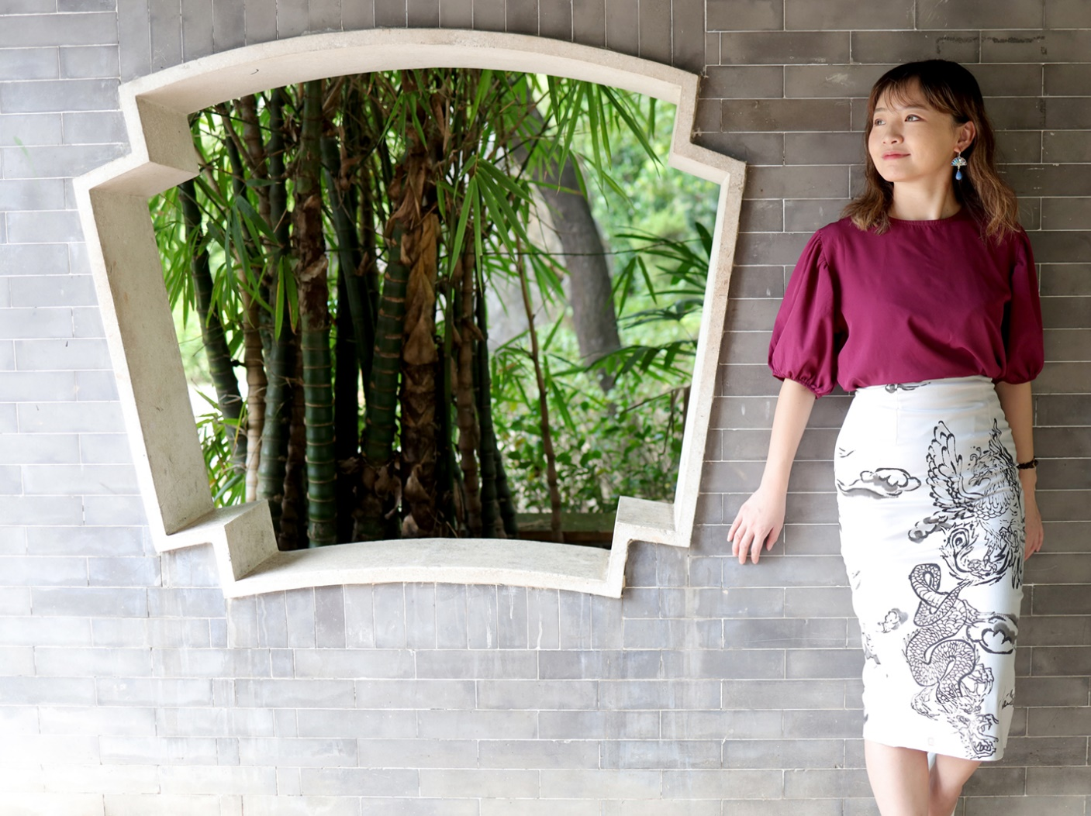
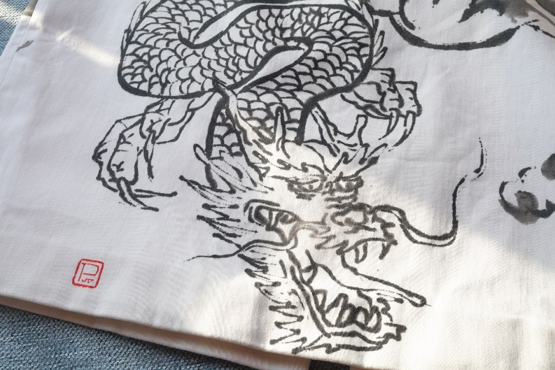
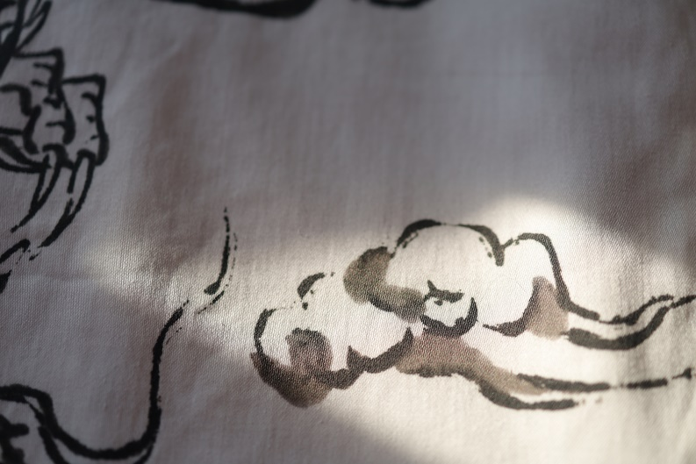
Designed by: 郭惠嵐 Stepbe Kwok
Graphic Design for Fashion

Slide 46
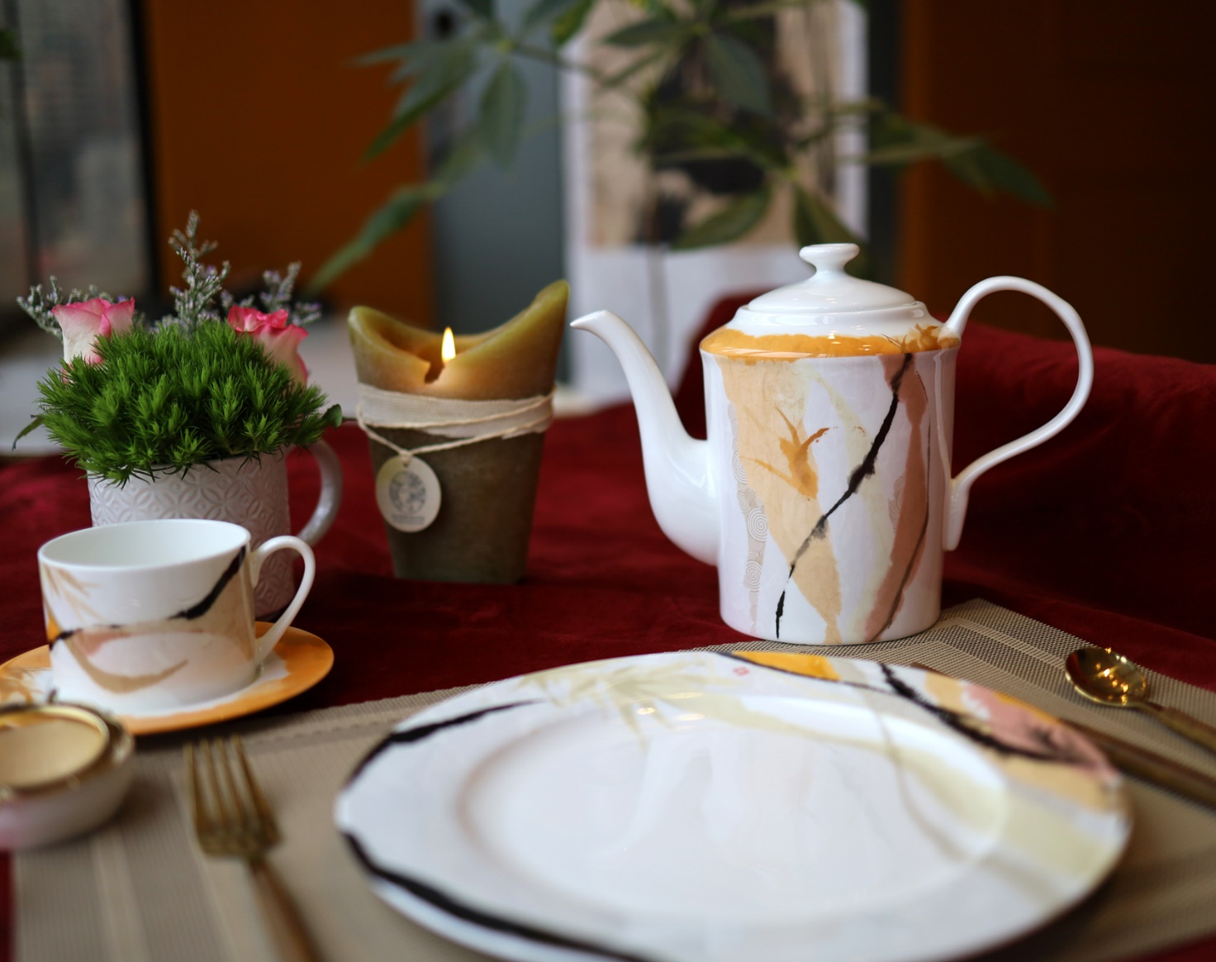
Tableware Design

Slide 47
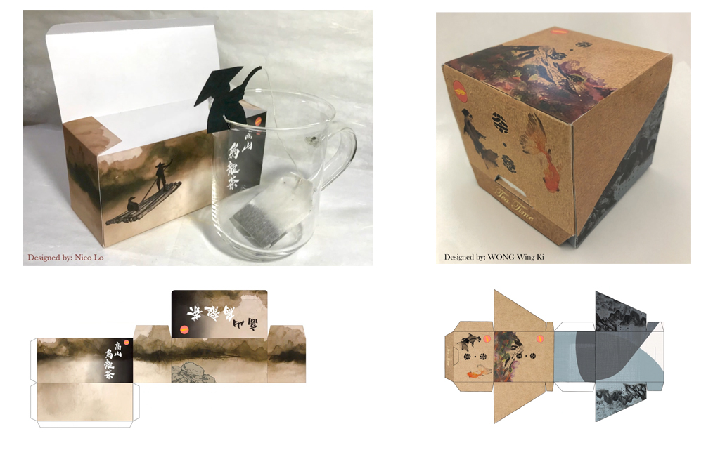
Package Design
(tea box)

